Slide 1
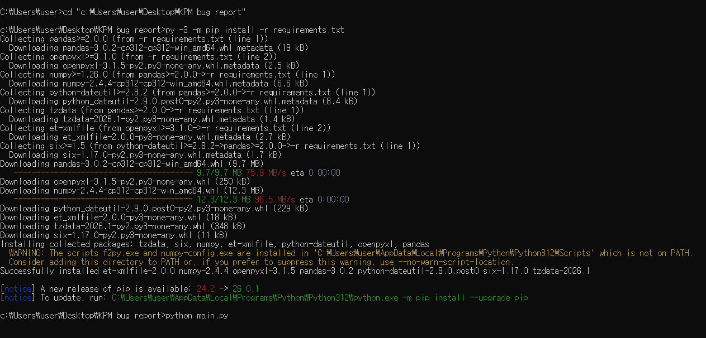
cd "c:\Users\user\Desktop\KPM bug report“
python -m pip install -r requirements.txt
python main.py

Slide 2
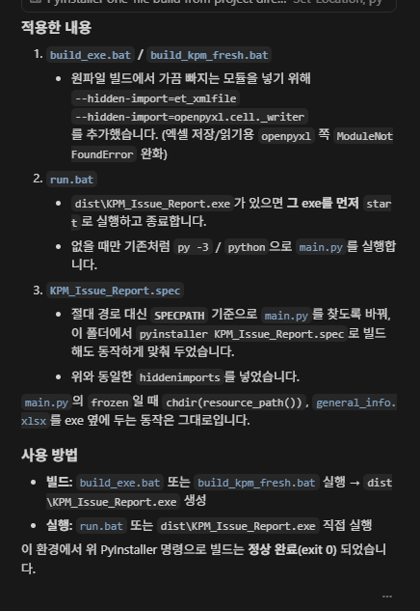

Slide 3
